Slide 1
Lecture : 1
Abdullah Mansoor

Slide 2
Artificial Intelligence: An Introduction
Abdullah Mansoor

Slide 3
Artificial Intelligence

Slide 4
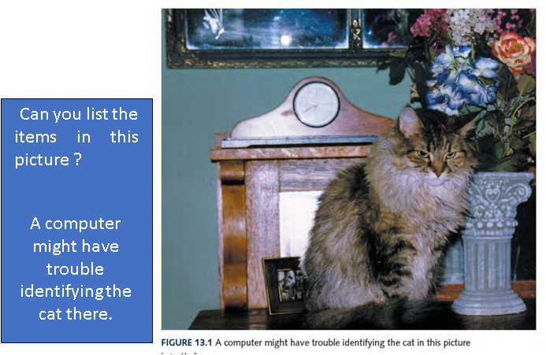
Artificial intelligence (AI)
This is what Humans do best
The study of computer systems that attempt to model and apply the intelligence of the human mind.
For example:
Can you count the distribution of letters in a book?
Add a thousand 4-digit numbers?
Match finger prints?
Search a list of a million values for duplicates6?
Can you list the items in this picture ?
A computer might have trouble identifying the cat there.
writing a program to pick out objects in a picture:

Slide 5
What is Machine Learning?
Arthur Samuel (1959):
Machine Learning: Field of study that gives computers the ability to learn without being explicitly programmed.
Mathematical perspective:
No Magic
Machine Learning is just a Function Approximation activity
Not Explicitly Coded for Each & Every Situation.
if-else VS Function Approximation

Slide 6
Deep Learning
Deep Learning is a new area of machine learning research, which has been introduced with the objective of moving machine learning closer to artificial intelligence.
It relates to study of ‘neural networks’ in the human brain and, under this perspective, the deep learning tries to emulate the functions of inner layers of the human brain, creating knowledge from multiple layers of information processing.

Slide 7
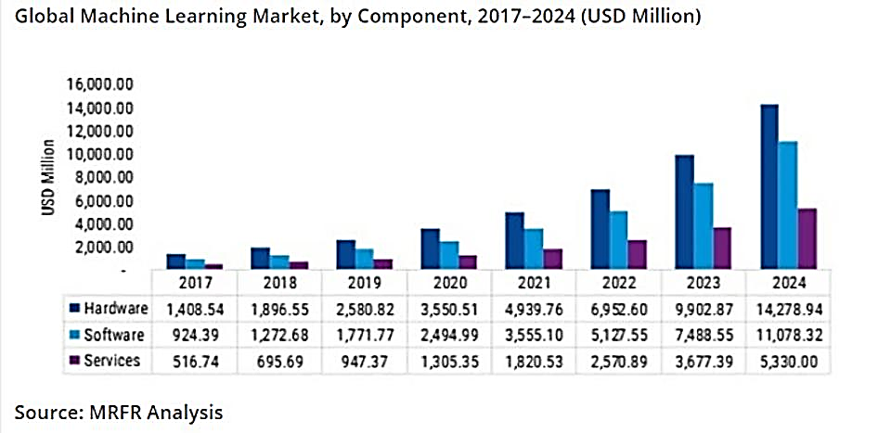
Market Growth
Machine Learning Market to Grow by USD 11.16 Billion During 2020-2024

Slide 8
Applications
Computer Vision
Natural Language Programming
Product Design
Predictive Analysis
Network Security

Slide 9
1- Computer Vision
Security & Survelience
Product Inspection and Quality Control
Opticl Character Recognition
Medical Diagnosis: X-ray & MRI Desease Detection
User Experience Enhncement: Auto-photo Tagging

Slide 10

1- Computer Vision Security & Survelience

Slide 11


1- Computer Vision Image Generation: Deep Fakes
Deep Fake:
https://www.youtube.com/watch?v=gLoI9hAX9dw

Slide 12
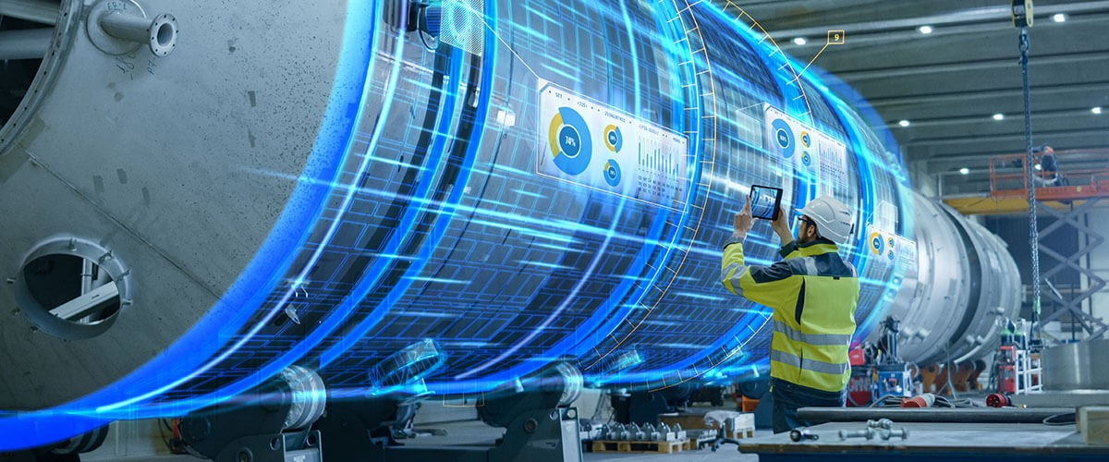
1- Computer Vision Product Inspection and Quality Control

Slide 13
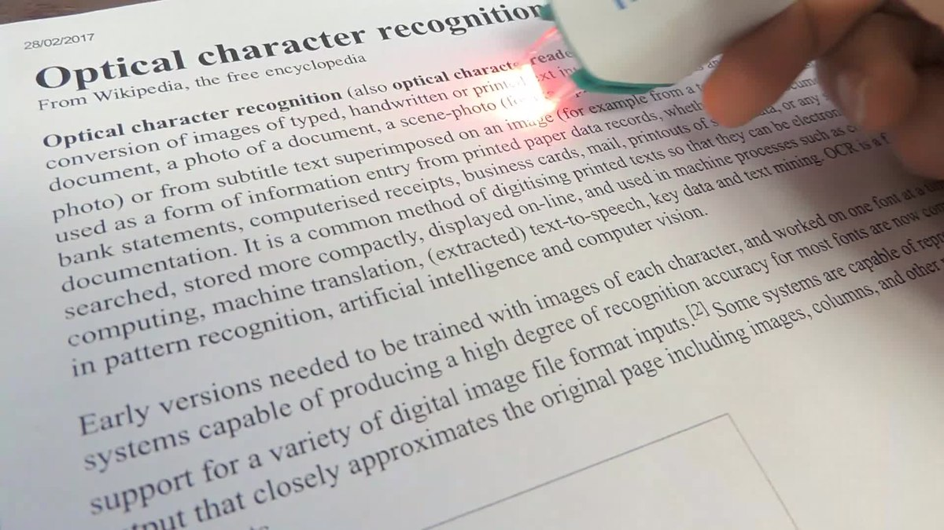
1- Computer Vision Optical Character Recognition

Slide 14
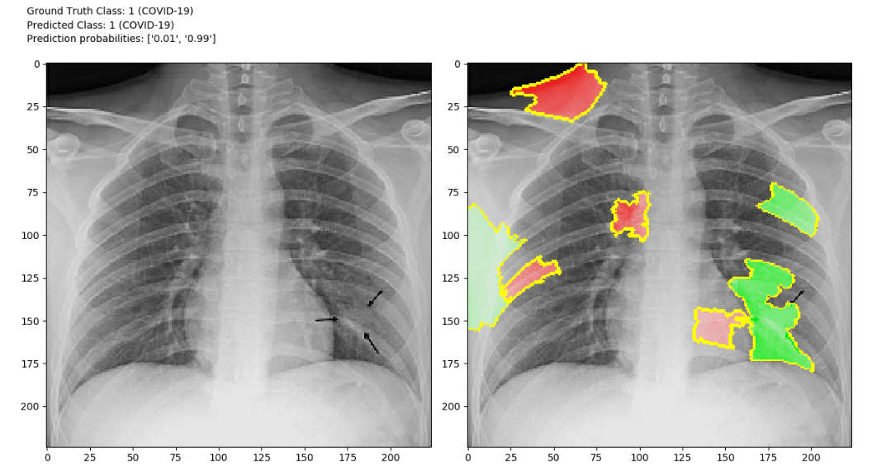
1- Computer Vision Medical Diagnosis: X-ray & MRI Desease Detection

Slide 15
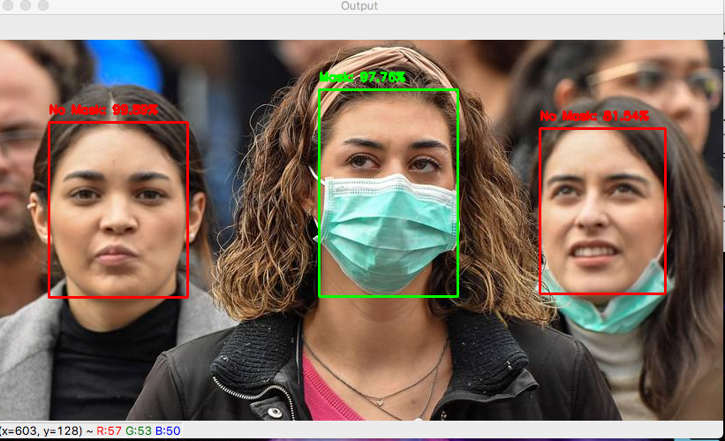
1- Computer Vision User Experience Enhncement: Auto-photo Tagging

Slide 16
2- Natural Language Programming
Information Extraction
Language Apprehension/Understanding: SIRI
Language Generation
Sentiment Analysis: Plotical, Commercial Applications

Slide 17
2- Natural Language Programming GPT3 : Language Generation
GPT : Language generation
Human Input:
In a shocking finding, scientist discovered a herd of unicorns living in a remote, previously unexplored valley, in the Andes Mountains. Even more surprising to the researchers was the fact that the unicorns spoke perfect English.
DL Model Output:
The scientist named the population, after their distinctive horn, Ovid’s Unicorn. These four-horned, silver-white unicorns were previously unknown to science. Now, after almost two centuries, the mystery of what sparked this odd phenomenon is finally solved. Dr. Jorge Pérez, an evolutionary biologist from the University of La Paz, and several companions, were exploring the Andes Mountains when they found a small valley, with no other animals or humans. Pérez noticed that the valley had what appeared to be a natural fountain, surrounded by two peaks of rock and silver snow.

Slide 18
3- Product Design
Generative Design
https://www.youtube.com/watch?v=vtfNlWEJxw4
https://www.youtube.com/watch?v=1yuzHygJGvc
https://www.youtube.com/watch?v=aR5N2Jl8k14
Character Design
https://generated.photos/face-generator
Artbreeder

Slide 19
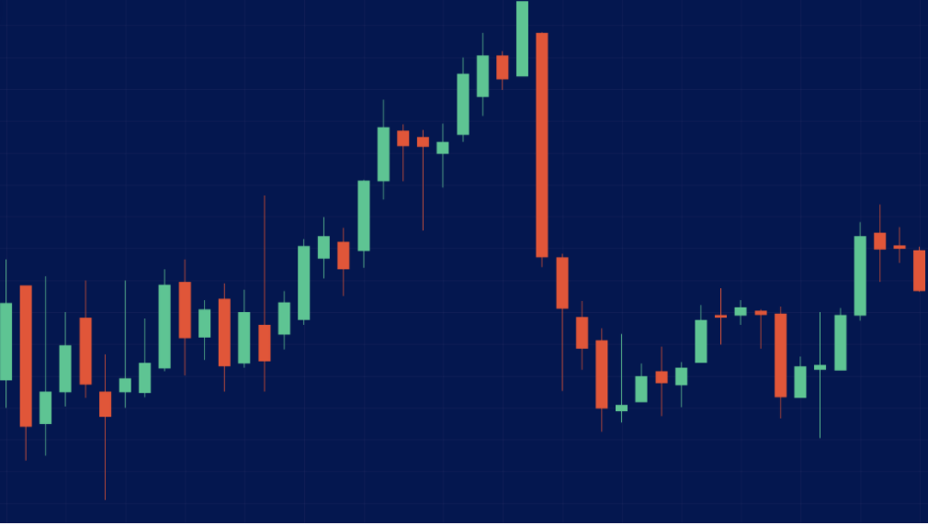
4- Predictive Analysis
Price/Stocks Forecasting
Weather Forecasting
Earthquake Forecasting
Election Result Forecasting

Slide 20
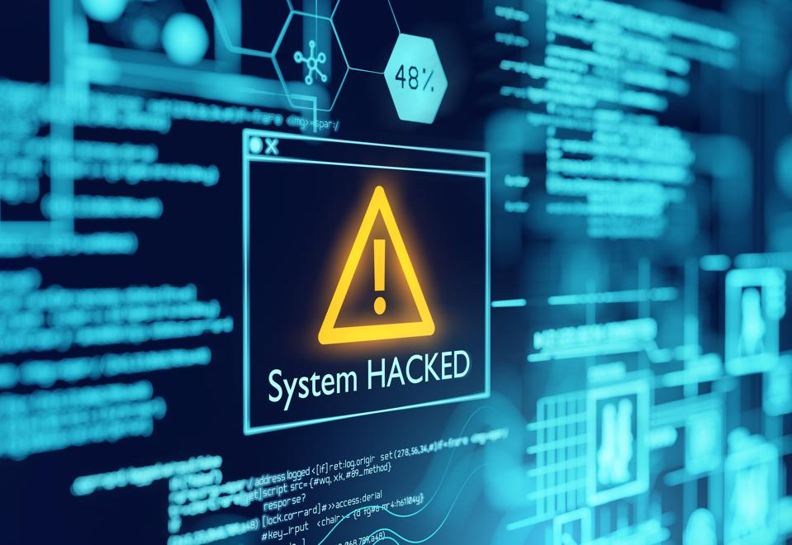
4- Network Security Network Intrusion Detection

Slide 21
AI and Big Data

Slide 22
AI and Big Data
Big Data
IoT Networks
Wearables
Social Media
Distributed Storage
Distributed Processing

Slide 23
1- Big Data
Machine/Deep Learning Algorithms are data hungry
Sight & Insight - بصارت ، بصیرت and Experience = Data
More Data leads to finding more fine patterns in the data
More Complex Models require more data to be productive

Slide 24
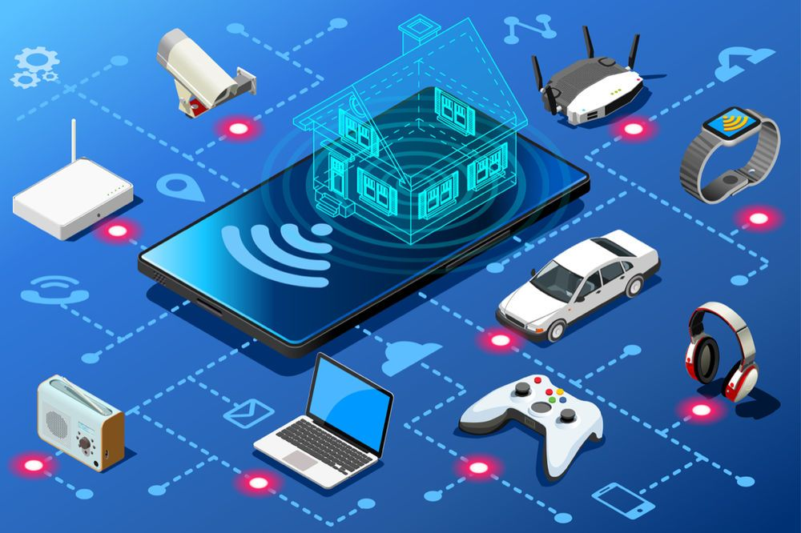
2- IoT Networks

Slide 25
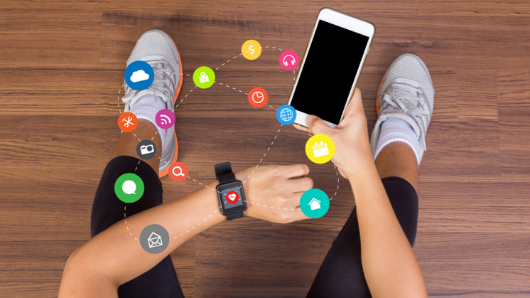
3- Wearables
The future of wearable technology is not wearables, it is analysing the data.
https://www.theguardian.com/technology/2015/jan/06/future-wearable-technology-analysing-data

Slide 26
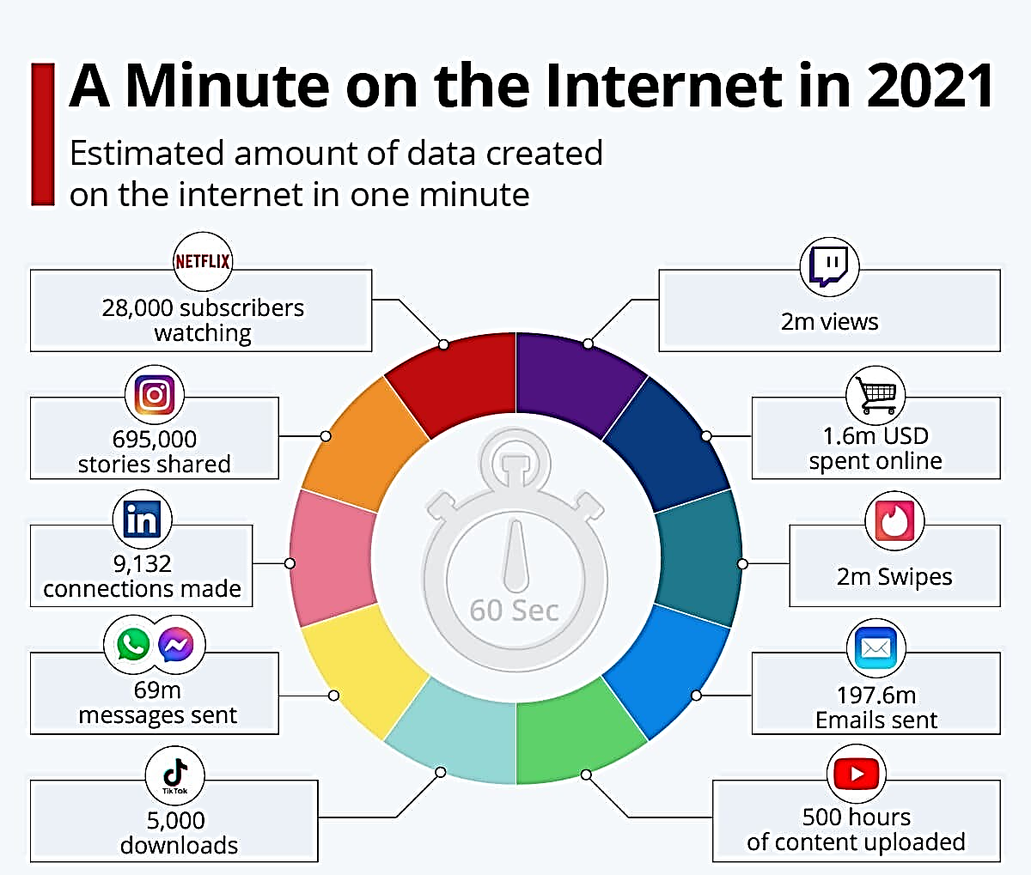
4- Social Media

Slide 27
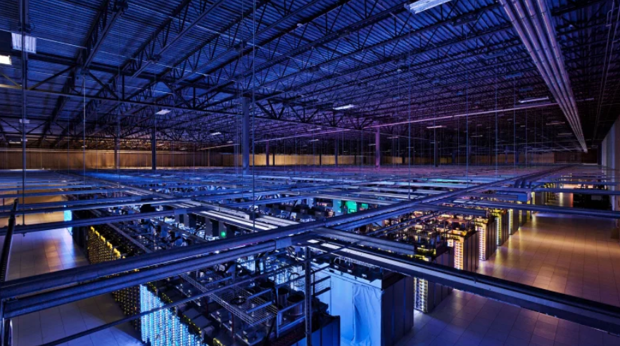
5- Distributed Storage

Slide 28
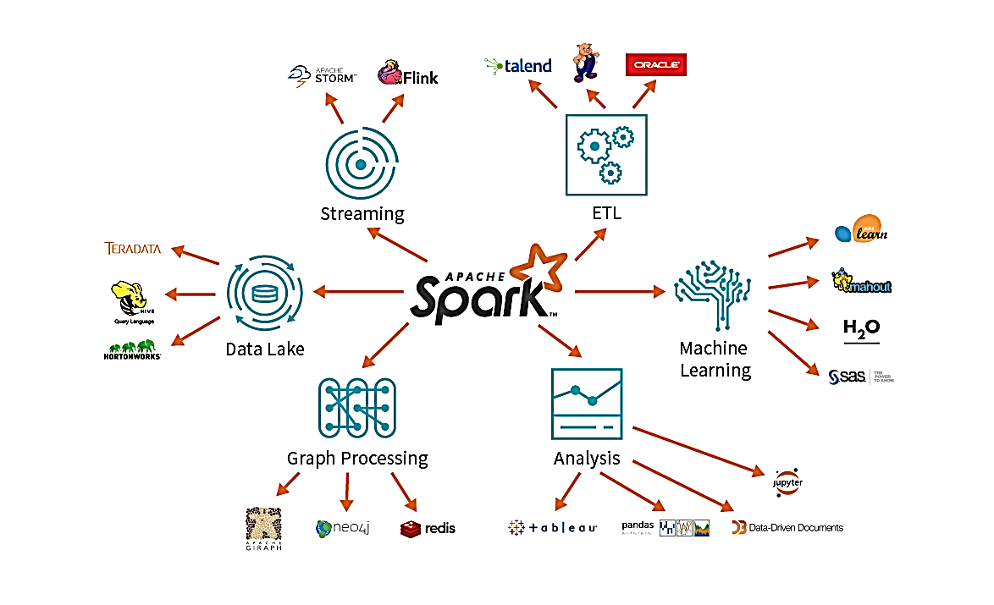
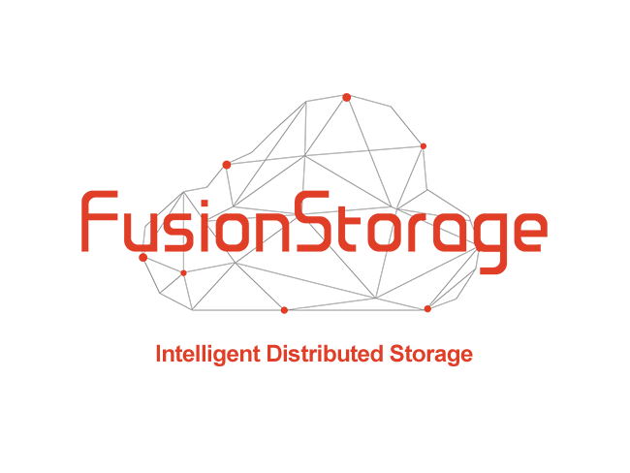
6- Distributed Processing of Data
Cloud Computing
Microsoft Azure
Huawei Cloud
Google Cloud

Slide 29
Welcome Aboard!

